Slide 1
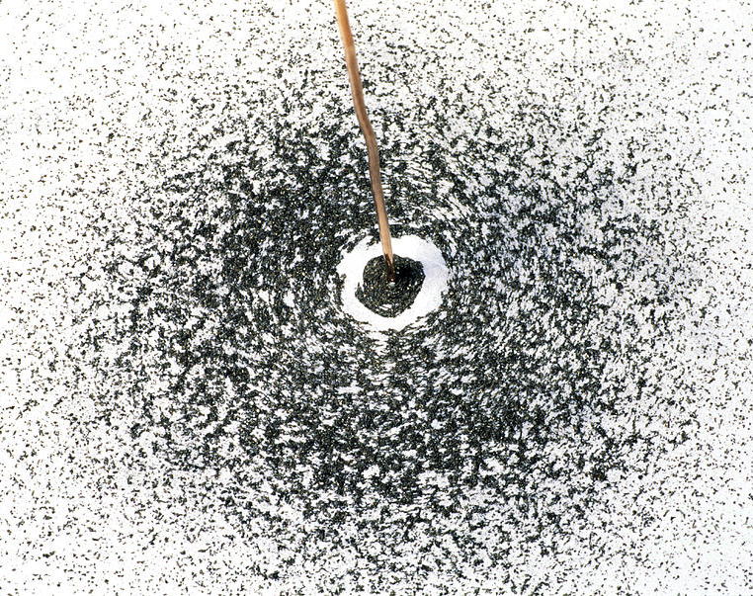
PHYS& 222 – Engineering Physics II Final Theory Presentation Winter 2021 (2947)
Johnathan Chivington
North Seattle College, BS (Physics)

Slide 2
Goals
The objective of this project was to utilize the analysis of a slidewire placed parallel to a current-carrying wire to:
• Solve a problem based on magnetic induction
• Choose appropriately among Maxwell’s Equations
• Work with vector notation and operations
• Break up a situation into infinitesimals, then integrating to obtain an answer

Slide 3








Overview & Strategy
Maxwell’s Third Equation (Faraday’s Law) states the induced emf in a closed loop equals the negative of the time rate of change of magnetic flux through the loop.
Therefore, to find the induced emf and current, we will first find an expression for the change in flux over time, using and equations from chapters 28 and 29.
We will need to develop our expression using an equation that is dependent on the radial distance from the current wire so that we can integrate in the outward direction from the wire to account for the change in field strength over distance.
Evaluating the integral will yield an appropriate expression for the induced emf in terms of both the total change in flux, as well as the distance from the current wire.
Finally, once we have the value for the emf, we can solve for the induced current using Ohm’s Law.

Slide 4
Execution
The magnetic field (B) due to the current-carrying wire is concentric with the wire such that the field is directed straight down into the plane to the right of the wire, so the area vector (A) is chosen to point straight down into the plane as well. With this choice, a positive emf would be directed clockwise around the slidewire circuit.
Since (A) and (B) point in the same direction:
Magnetic field (B) at a distance (r), radially outward from a straight current carrying conductor:
Area of magnetic field (B) enclosed by the slide at a given time (t):

Slide 5
Execution (continued)
With a fixed length (d = vt) at time (t), integrating across the width (dr) of the enclosed magnetic field, which corresponds to distance traveled radially outward from the current carrying wire, the area element (dA) and flux element (dΦ) are:
We can now set up our integral for the time rate of change of magnetic flux through the circuit. Evaluating that integral will yield an expression for the induced emf, according to Maxwell’s Third Equation (Faraday’s Law) :

Slide 6
Execution (continued)
Finally, we solve for the induced emf and then use that information to solve for the induced current:

Slide 7
Conclusion
We were able to successfully incorporate all the stated goals of the task in calculating the induced emf and current. In doing so, we also arrived at a result that confirmed our expectations about the experimental setup.
When developing our expression for induced emf, we noted that a positive result would indicate a clockwise direction. Since the slide travelled in a direction that increased the flux over time, a counterclockwise direction was expected, and this was confirmed by the negative result of the induced emf.
Overall, this analysis provided valuable insights into the nature of induction, the usage of Maxwell’s Equations, and helped solidify our intuitions around the process of breaking a complex problem into infinitesimals and then integrating to obtain a solution.

